Slide 1



CIT 596 MODULE 12.3
Reductions
Sampath Kannan

Slide 2



IMPLICATIONS OF P BEING EQUAL TO NP
Settling the P versus NP question will have huge ramifications:
If P$=$NP, tens of thousands of real world problems will have efficient solutions.
This will have enormous implications for business, medicine, science, etc.
Automation could replace human ingenuity in many more spheres.
On the down side, cryptography (as we use it today) will no longer be possible.
Most researchers in the field do not believe that P=NP.
But how do we go about finding the answer?

Slide 3

ONE APPROACH
Identify the “hardest” problems in NP, such that solving any one of them in polynomial time would show that P$=$NP.
Try your best to find a polynomial time algorithm for one such problem.
But how do we identify the hardest problems in NP?
Attempted definition: a problem $π$ is “a hardest problem” in NP if, given an efficient algorithm to solve $π$, you can use it (as a subroutine) to solve every other problem in NP.
Formalizing this: reductions

Slide 4

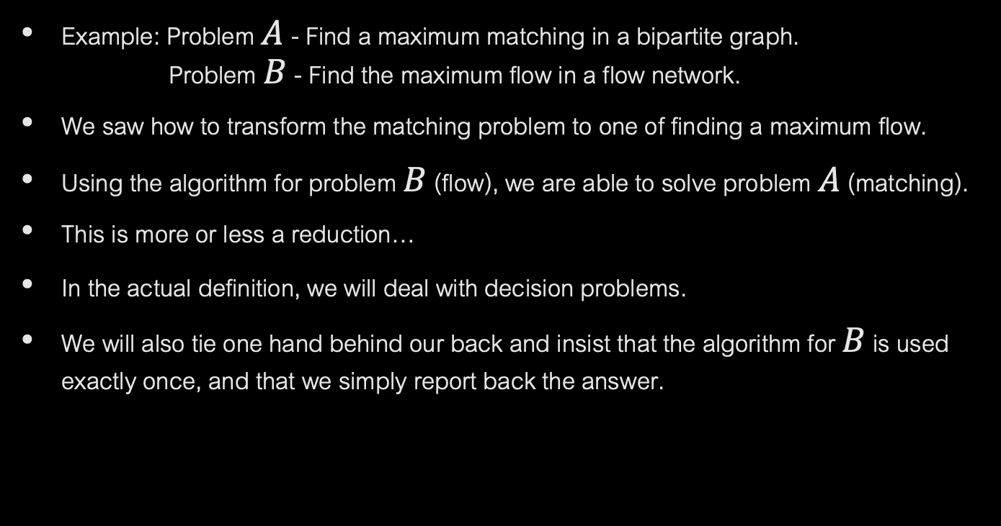

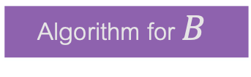

REDUCTIONS
Example: Problem $A$ - Find a maximum matching in a bipartite graph. Problem $B$ - Find the maximum flow in a flow network.
We saw how to transform the matching problem to one of finding a maximum flow.
Using the algorithm for problem $B$ (flow), we are able to solve problem $A$ (matching).
This is more or less a reduction…
In the actual definition, we will deal with decision problems.
We will also tie one hand behind our back and insist that the algorithm for $B$ is used exactly once, and that we simply report back the answer.
Input $x$ to $A$
Reduction
$$f$$
$$f(x)$$
Algorithm for $B$

Slide 5
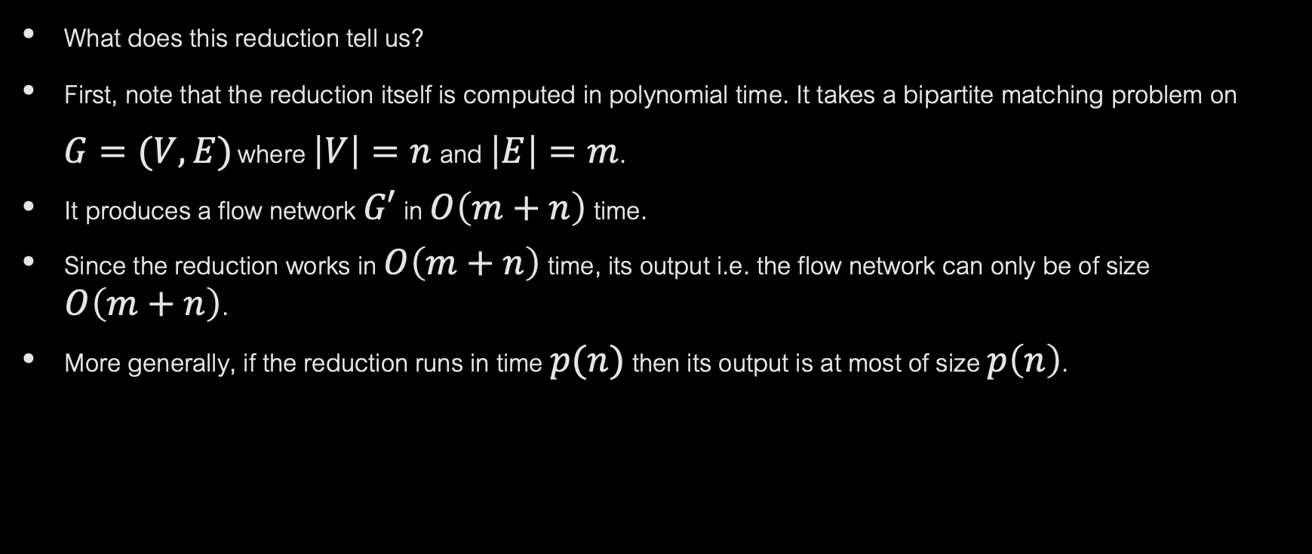
REDUCTIONS (CONTINUED)
What does this reduction tell us?
First, note that the reduction itself is computed in polynomial time. It takes a bipartite matching problem on
$G=(V,E)$ where $\left|V\right|=n \text{and} \left|E\right|=m$.
It produces a flow network $G′$ in $O\left(m+n\right)$ time.
Since the reduction works in $O\left(m+n\right)$ time, its output i.e. the flow network can only be of size $O\left(m+n\right)$.
More generally, if the reduction runs in time $p(n)$ then its output is at most of size $p\left(n\right)$.

Slide 6
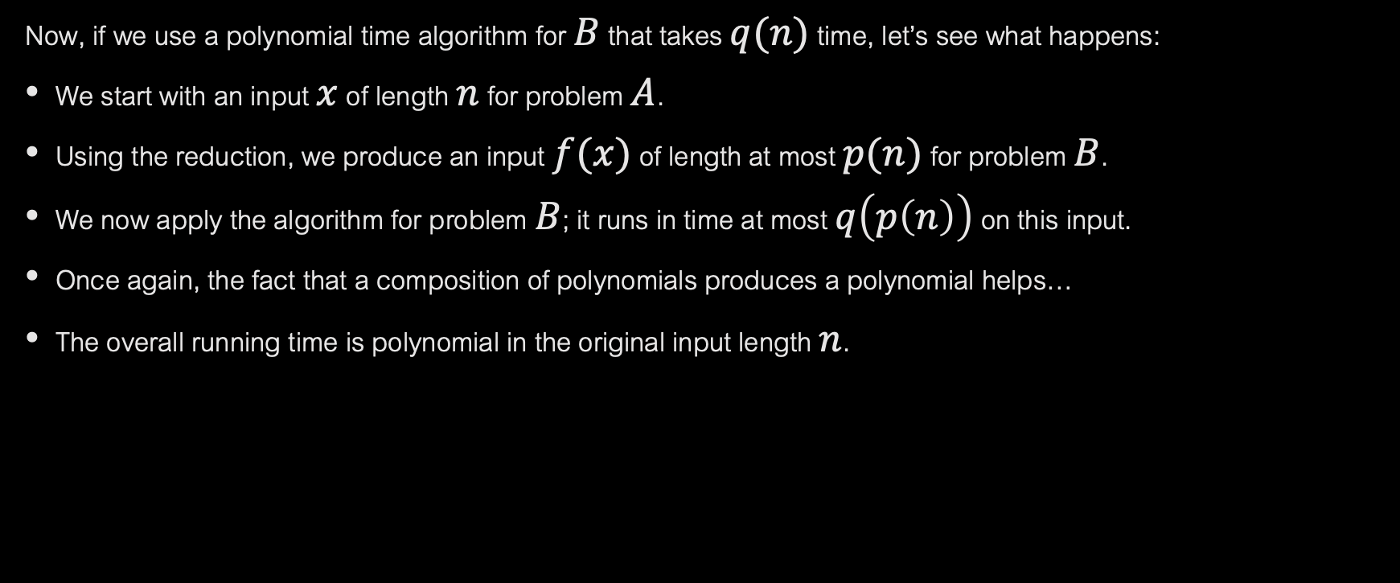
REDUCTIONS (CONTINUED)
Now, if we use a polynomial time algorithm for $B$ that takes $q(n)$ time, let’s see what happens:
We start with an input $x$ of length $n$ for problem $A$.
Using the reduction, we produce an input $f(x)$ of length at most $p(n)$ for problem $B$.
We now apply the algorithm for problem $B$; it runs in time at most $q\left(p\left(n\right)\right)$ on this input.
Once again, the fact that a composition of polynomials produces a polynomial helps…
The overall running time is polynomial in the original input length $n$.

Slide 7

POLY-TIME REDUCTIONS
Decision problem A reduces in polynomial time to decision problem B (written as A $≼_{P}B$) if:
There exists a poly-time computable function $f$ mapping inputs to A to inputs to B.
$x$ is a YES instance of A $⟹f(x)$ is a YES instance of B.
$x$ is a NO instance of A $⟹f(x)$ is a NO instance of B.
To construct and prove a reduction correct, we have to find the function $f$…
… and prove the 3 properties above.

Slide 8
POLY-TIME REDUCTIONS: IMPLICATIONS
What does it mean if there is a poly-time reduction from A to B ?
If B is solvable in poly-time, then so is A. Just map the input to A to an input to B, and use the algorithm for solving B.
If A is not solvable in polynomial time, then neither is B. This is an interesting use of reductions!
It shows that B is “hard” if A is hard. This is the direction we will use in this portion of the course.

